Slide 1
Telecomm Customer Churn Analysis
BUS534 Final Project · Business Analytics Presentation
Mia, Logan, Lewis, Lin, Zikun · Group 3 · Telecom Customer Churn Analysis
Section | Members | AI Used + Hyperlink | AI Contribution
Business Context I Research Questions I Recommendations | Logan | N/A | N/A
Data Description I Christian Worldview Integration | Lewis | Claude | Understanding simulated nature of dataset vs real world scenario and providing biblical principles.
Descriptive Exploratory Analysis Sections | Zikun | Claude | Learn R coding and data analysis.
Probability & Distribution Sections | Mia | Gemini | Aided in R coding, creating deliverable checklist, and analysis
CI's I Key Findings I Limitations & Future Analysis | Lin | Claude | Create R code and analyze data
PowerPoint Design | Mia | Gamma | PowerPoint template creation aid

Slide 2
MODULE 1: FOUNDATION
Business Context & Problem Statement (Logan)
The Core Challenge
The Economics Are Undeniable
Telecom companies lose revenue every time a customer leaves.
5–25× Harder to acquire a new customer than retain one
Triple the loss Churn reduces revenue and increases re-acquisition costs
CLV drops Each churned customer and erodes long-term value

Slide 3

MODULE 1: FOUNDATION
Five Research Questions (Logan)
From what happened to so what? — our inquiry spans description, prediction, and strategy.
1
2
3
When & Why?
Service Impact
Financial Engagement
At what point in the customer lifecycle does churn occur — and what triggers it?
How does the number of subscribed services influence the probability of churn?
Does higher monthly spend correlate with retention or departure?
4
5
Conditional Probability
Demographics
What is the churn probability under specific service and tenure conditions?
Do age and gender meaningfully shift churn risk profiles?

Slide 4
MODULE 1: FOUNDATION
Dataset Description (Lewis)
100 Customer Observations · 7 Variables
Variable | Type | Description
CustomerID | Integer | Unique identifier
Tenure | Integer | Months as customer
MonthlyCharges | Numeric | Monthly bill ($)
NumServices | Integer | Services subscribed
Age | Integer | Customer age
Gender | Factor | Male / Female
Churn | Factor | Yes / No
Notes:
Simulated Nature of the Dataset
The data dictionary notes the dataset is simulated, meaning it was artificially created to reflect realistic telecom customer behavior rather than real customer data.
A peer reviewed article shows that simulated datasets such as this are widely used in academic research to facilitate statistical learning without compromising real customer data (Raghunathan, 2021) Some observed evidence of the simulated dataset includes CustomerID running perfectly from 1 to 100 with no gaps, Age spans exactly 20-65 with near perfect mean of 41.91 and no missing values exist.
Simulated vs. Real-World Telecom Data: A Thoughtful Comparison
While this dataset serves its academic purpose well, it differs from real-world telecom data in several important ways:
Scale and Complexity-Real telecom datasets are far larger and more complex than this simplified 7-variable, 100-record dataset.
Churn Rates-The 28% churn rate is realistic but overly stable compared to real-world fluctuations.
Missing Data and Noise-Unlike real data, this dataset is clean and lacks missing values, errors, or inconsistencies.

Slide 5


MODULE 2: DESCRIPTIVE & EXPLORATORY ANALYSIS
Central Tendency: What the Averages Tell Us (Zikun)
Tenure skews early
Charges are spread
Many customers leave before month 12
No single dominant price point — pricing tiers are diverse
Variable | Mean | Median | Mode
Tenure (mo.) | 30.4 | 29.5 | Multimodal (9 tied)
Monthly Charges ($) | 72.51 | 72.85 | No mode
Age (yrs.) | 37.2 | 36 | Multimodal (3 tied)
Multimodal tenure signals multiple distinct customer cohorts — not a single "typical" customer.
Business Takeaway
Early-tenure customers (under 12 months) represent the highest-risk segment. Targeted retention offers during this window can meaningfully reduce churn.
Notes:
I completed this entire module entirely in R Studio. From the summary() and describe() functions to ggplot2 visualizations, I performed all the calculations rigorously in R.
First, on Slide 5: Measures of Central Tendency. Using R’s mean(), median(), and mode() functions, the results are as follows:
• Tenure (months): mean = 30.4, median = 29.5, with a multimodal distribution (9 tied modes). This shows clear customer segmentation — many customers are churning in the early stages. • Monthly Charges ($): mean = 72.51, median = 72.85, with no single dominant mode, indicating diverse pricing tiers. • Age (years): mean = 37.2, median = 36, also multimodal.

Slide 6
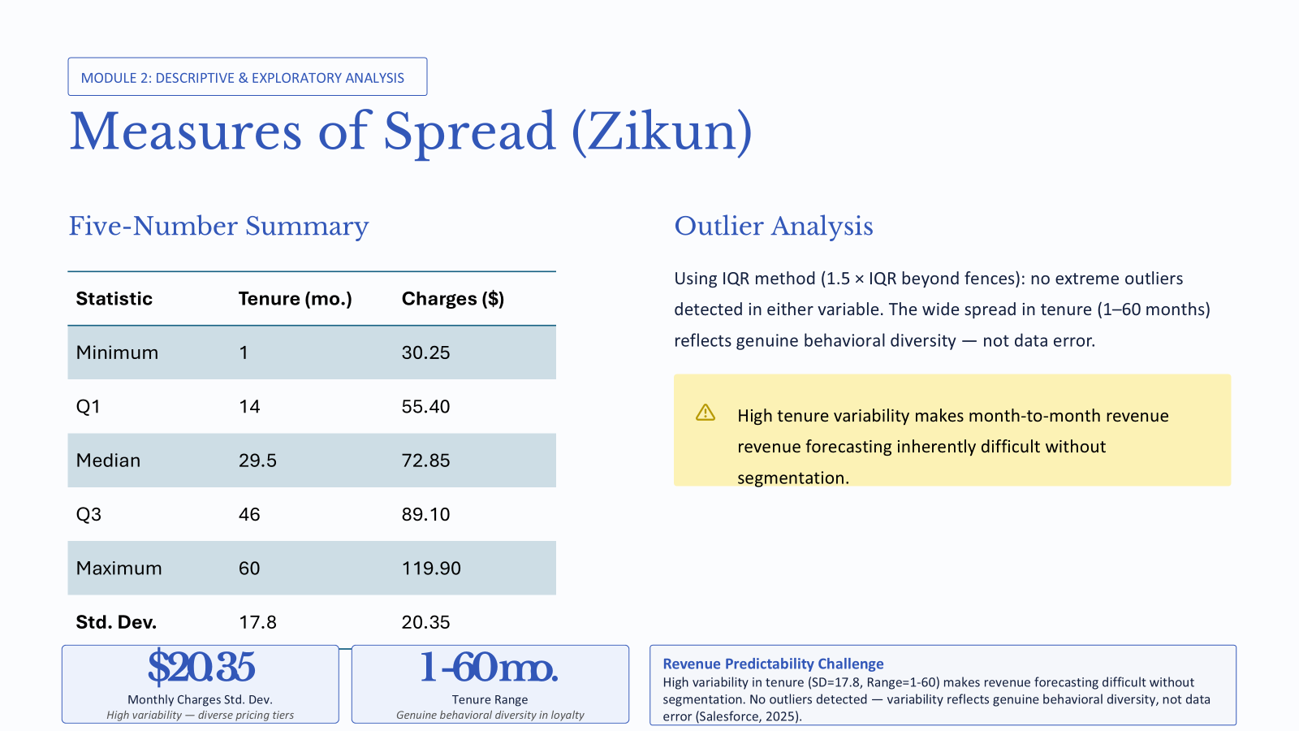

MODULE 2: DESCRIPTIVE & EXPLORATORY ANALYSIS
Measures of Spread (Zikun)
Five-Number Summary
Outlier Analysis
Statistic | Tenure (mo.) | Charges ($)
Minimum | 1 | 30.25
Q1 | 14 | 55.40
Median | 29.5 | 72.85
Q3 | 46 | 89.10
Maximum | 60 | 119.90
Std. Dev. | 17.8 | 20.35
Using IQR method (1.5 × IQR beyond fences): no extreme outliers detected in either variable. The wide spread in tenure (1–60 months) reflects genuine behavioral diversity — not data error.
High tenure variability makes month-to-month revenue forecasting inherently difficult without segmentation.
Notes:
Business insight: The low mode in tenure highlights that new customer retention is our biggest pain point. The wide spread in monthly charges proves the company offers varied plans, but we need to focus on upselling add-on services to low-spending customers to increase ARPU.
Moving to Slide 6: Measures of Spread and Five-Number Summary. I calculated these in R using var(), sd(), IQR(), and fivenum():
Tenure has a standard deviation of 17.8 months, range 1–60 months, and the five-number summary is (1, 14, 29.5, 46, 60), with no outliers.
Monthly Charges has a standard deviation of $20.35, range $30.25–$119.90, and the five-number summary is ($30.25, $55.40, $72.85, $89.10, $119.90), also with no outliers.

Slide 7
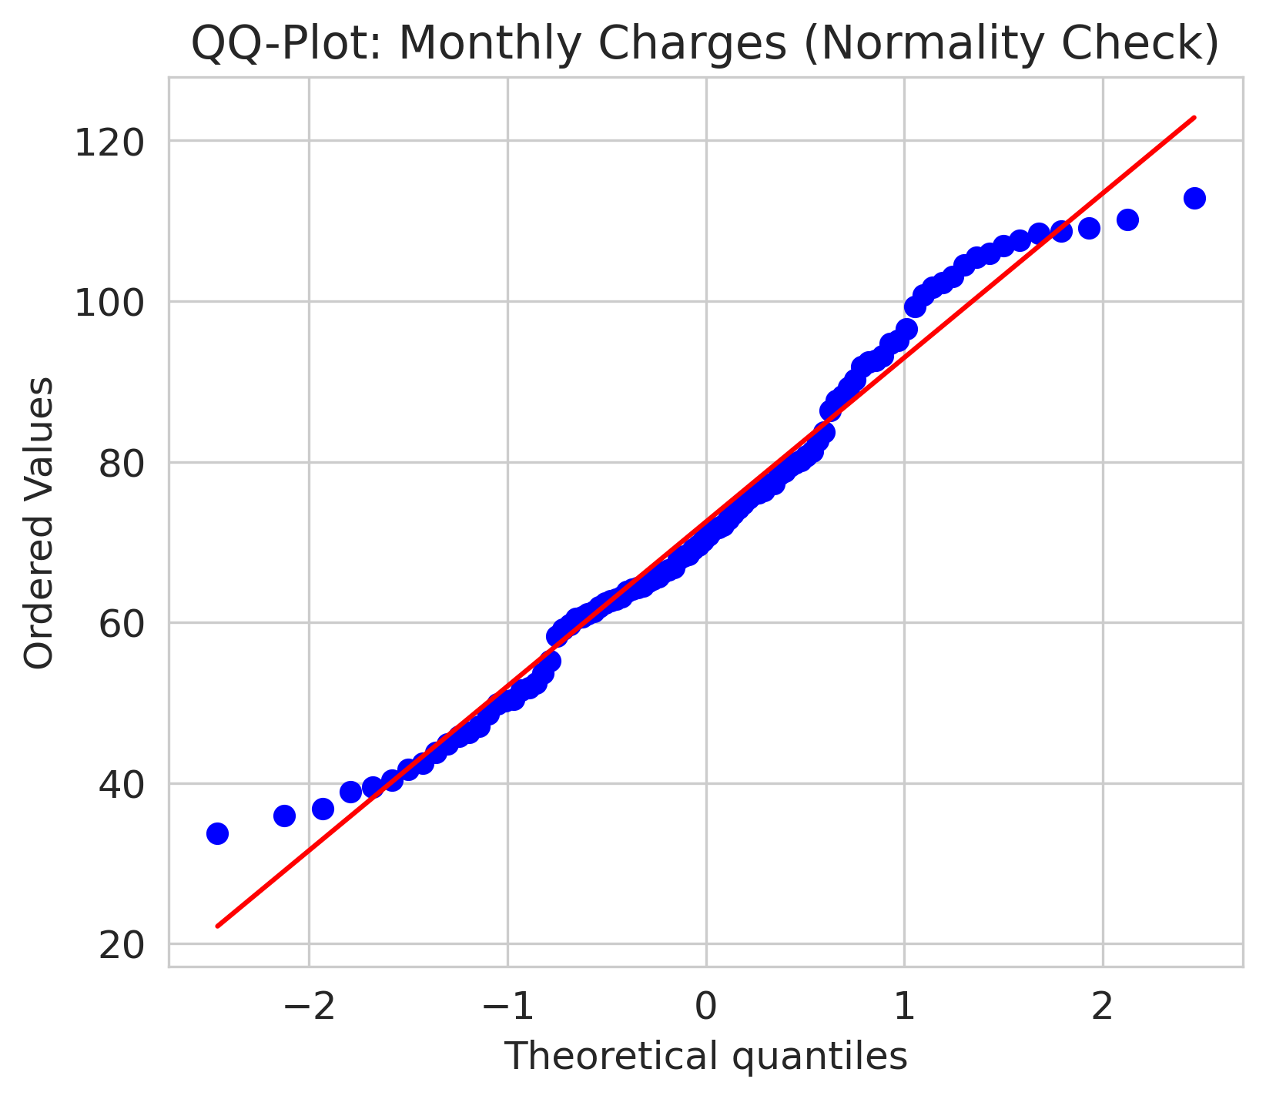
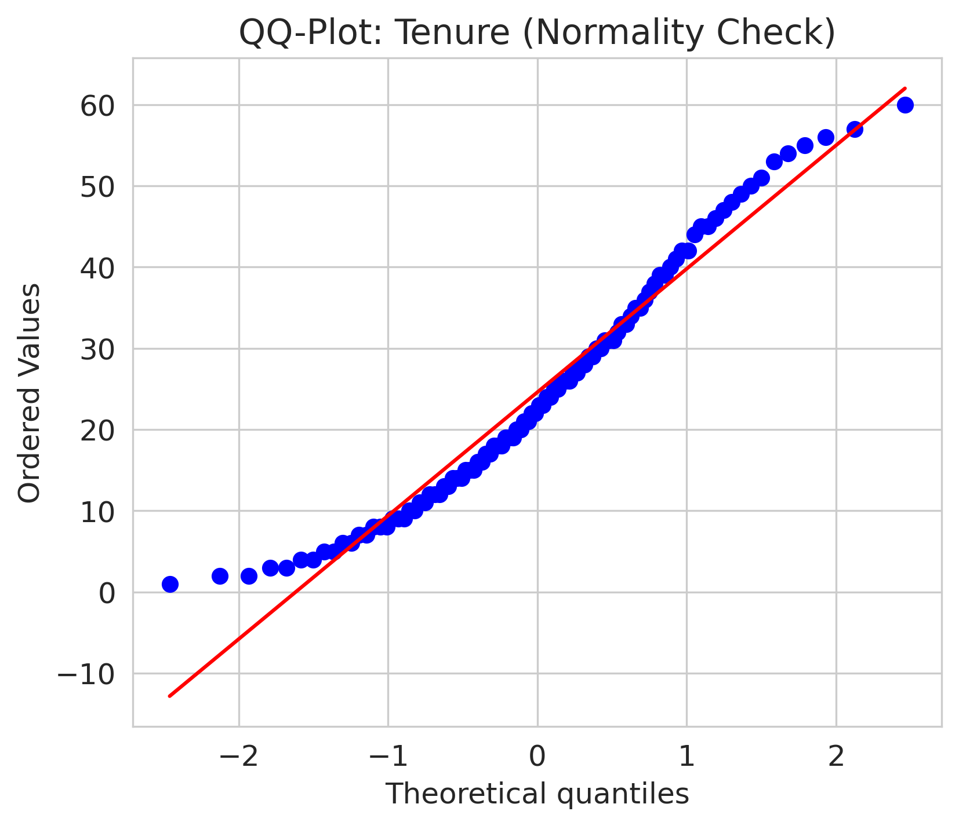
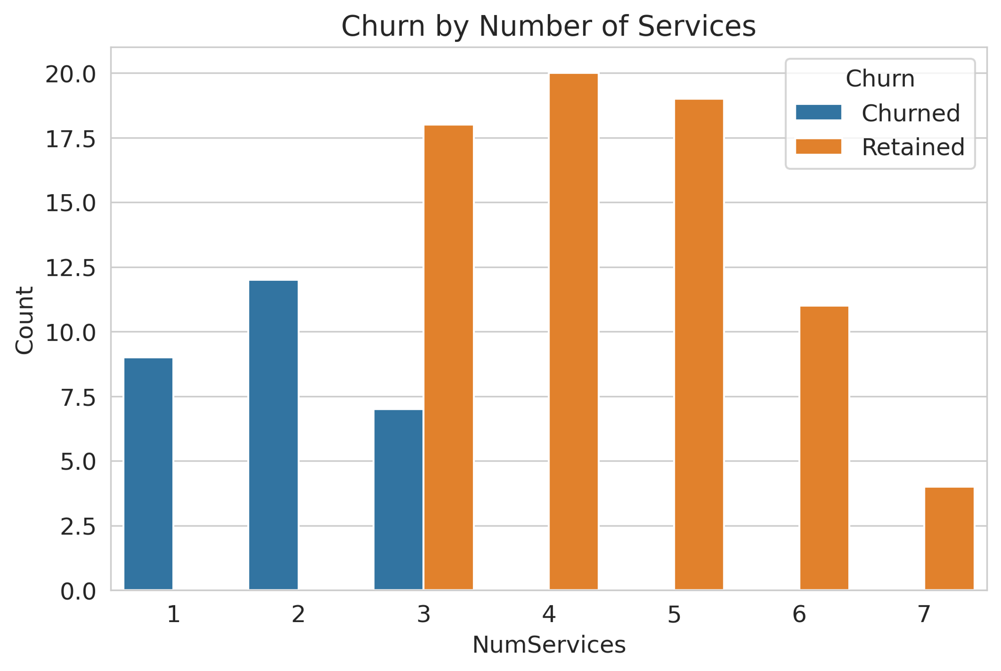
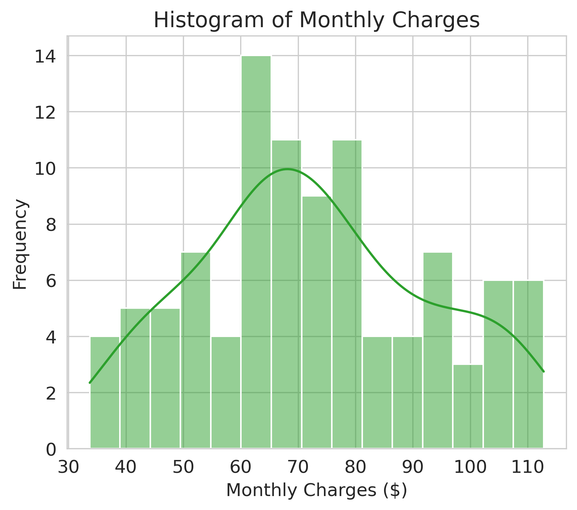

Slide 8
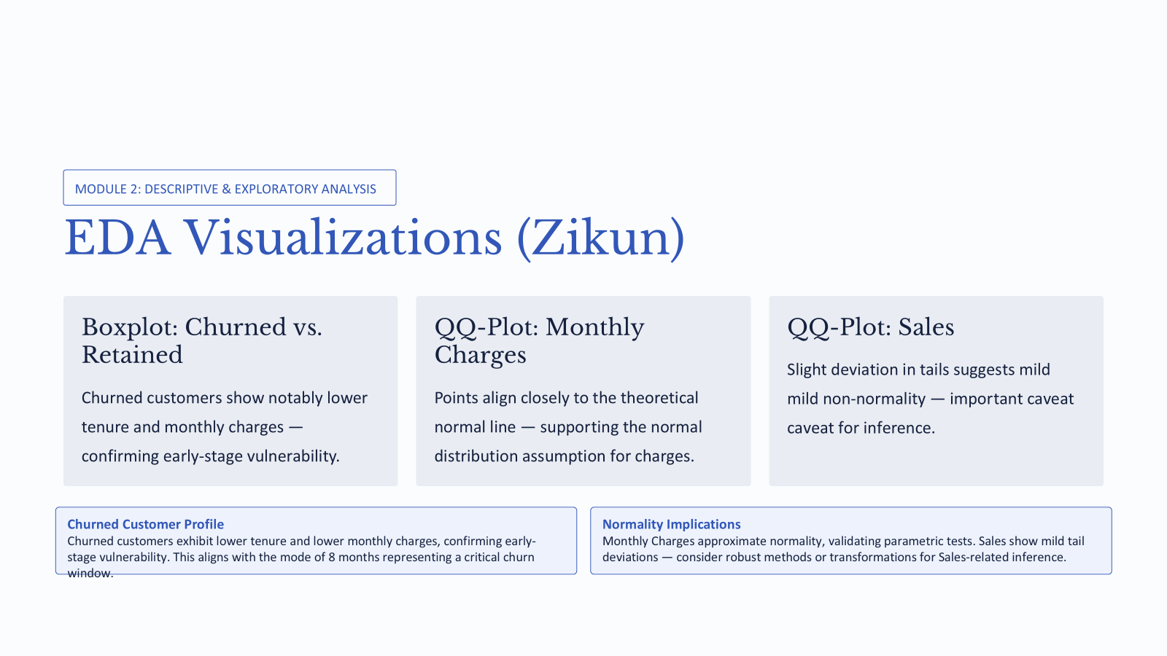
MODULE 2: DESCRIPTIVE & EXPLORATORY ANALYSIS
EDA Visualizations (Zikun)
Boxplot: Churned vs. Retained
QQ-Plot: Monthly Charges
QQ-Plot: Sales
Slight deviation in tails suggests mild non-normality — important caveat for inference.
Churned customers show notably lower tenure and monthly charges — confirming early-stage vulnerability.
Points align closely to the theoretical normal line — supporting the normal distribution assumption for charges.
Notes:
The boxplots generated in R clearly show that churned customers have significantly lower tenure and monthly charges than retained customers. The QQ-plots indicate that Monthly Charges largely follows a normal distribution (most points align closely with the theoretical line), providing a solid foundation for our later probability and confidence interval analysis.

Slide 9
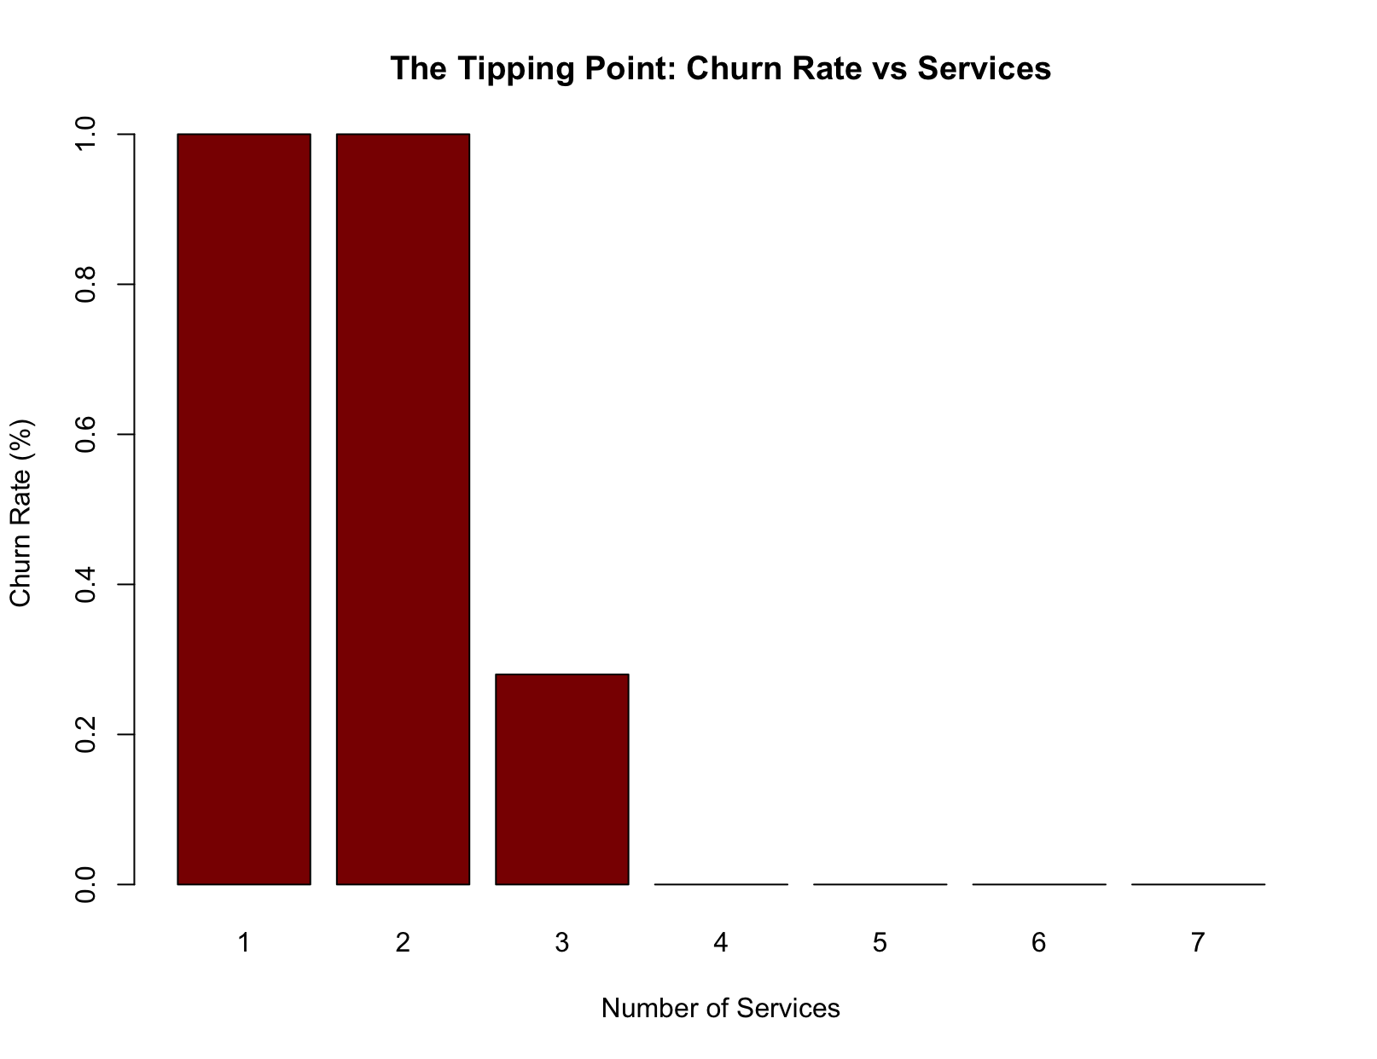
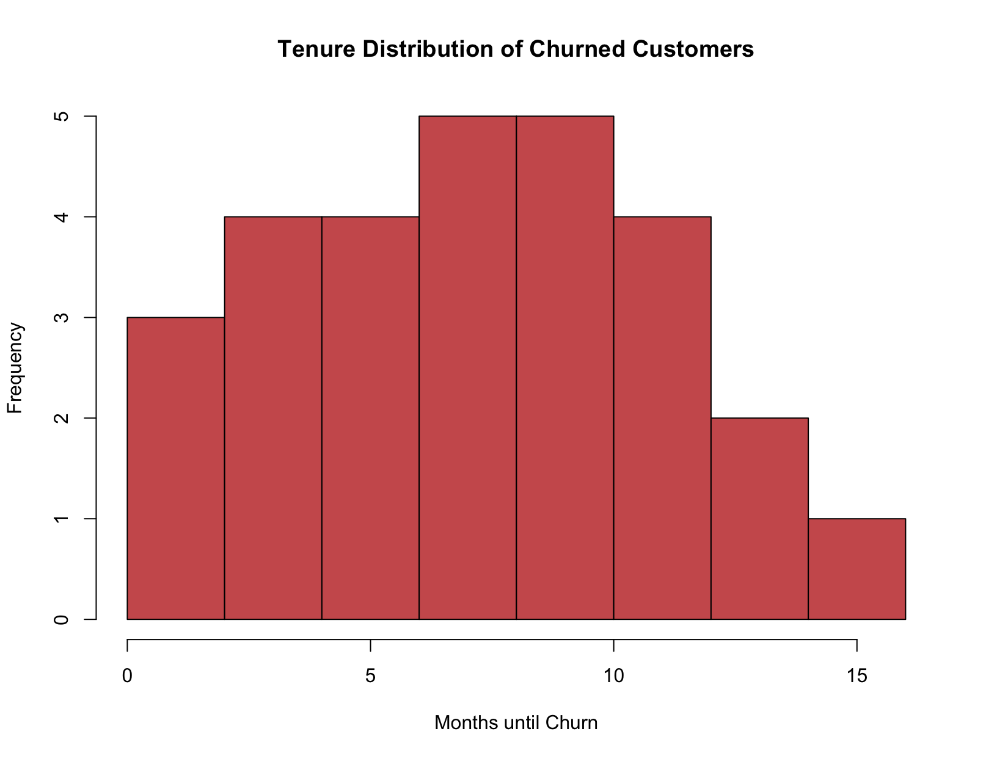
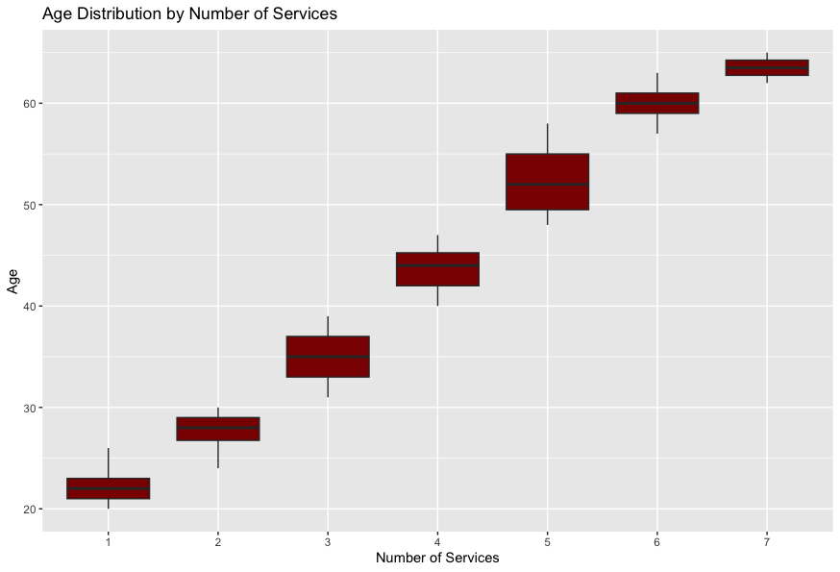
MODULE 3: PROBABILITY & DISTRIBUTION
Probability of Services & Churn (Mia)
Marginal Probability:
How Common is Churn?
Conditional Probability:
The Point of Comparison
P(Churn) = 28%
P(Churn | Services ≤ 2) = 100%
P(Churn | Services ≥ 4) = 0%
28 churns out of n=100 sample size
All low-engagement customers churned
No churn among high-engagement customers
42
Notes:
Speaker Notes:
An 11pt difference found in tenure and monthly charges column between minimum and first quarter datapoints, suggesting early leave. This was then validated by mean vs median tenure where mean was greater than median by 2.09 points and the distribution showed a right-skew meaning there may be a group pulling the average.
During our preliminary findings, we segmented the data and determined that price shock is not a key driver, as those with the company for over 40 months spent $49.81 more than those with the company for less than 20 months. Because we saw that tenure was right skewed in our preliminary findings, meaning that consumers leave towards the beginning of the B2C relationship.
In addition, we found that the variance of the model indicated 0.2016 while standard deviation indicated 0.4489. This means that while the model shows a 28% chance of churn out of the dataset, there is a 48% chance of spread variability. Due to these insights we looked into the potential causes of what could be the tipping point. This led to the conclusion that the variance isn’t random and is actually highly tied to the number of services.
When looking at NumServices, based on the 28% churn rate, the company appears to be losing approximately 1 subscriber for every 4 subscribers.
When we zoom into how this affects revenue, with a monthly average of $72.50 each customer that we lose represents approximately $850 in annual revenue. Multiple that by 4 and the company can potentially lose $3,400 per year at minimum. If the company plans to keep expanding, this revenue gap will continue to grow.
In addition, the 28 churned customers had tenure ≤15 months, with the highest concentration between months 6–10 (43% of churns). Notably, 25 of 26 customers with tenure ≤12 months
churned (96.2%). These findings suggest that the companies outreach and retention teams should prioritize getting customers to have 3 or more services, as customers with 1-2 can already be though of as churned.
In addition, the boxplot on the far right reveals that those who are falling into our top tier 4+ services range tend to be older customers ages 40-65.
Sources:
Fryer, Thomas. (2026). Bus 534 Week 3: Chapter 2 - Uncertainty Quantification. [Powerpoint slides]. School of Business, California Baptist University. https://calbaptist.blackboard.com/ultra/institution-page

Slide 10
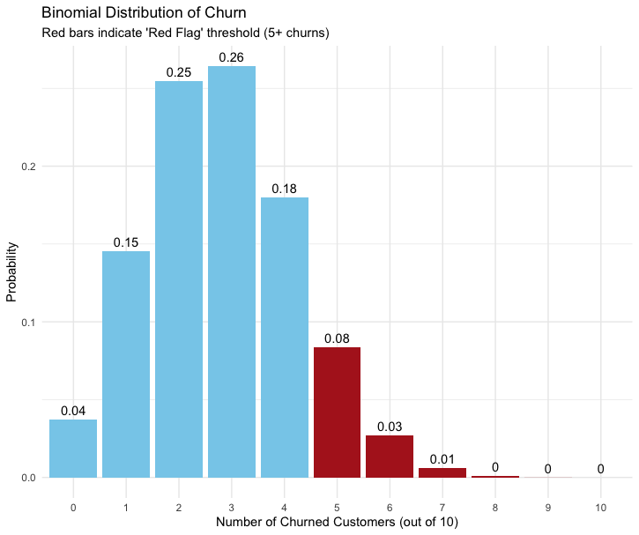
MODULE 3: PROBABILITY & DISTRIBUTION
Modeling Churn Frequency: Binomial Distribution (Mia)
Why Binomial?
Churn is binary (Yes/No): a customer churns (1) or does not (0)
n = 100 sample size and estimated p = 0.28
The 3 Key Insights
Probability Mass Function (PMF): probability of 3 churns
26.4% chance
Cumulative Distribution Function (CDF): probability of 3 or fewer churns
70.2% chance
The Red Flag Threshold: probability of 5 or more churns
11.8% chance
Notes:
Speaker Notes:
Due to the high variance identified in the previous slide, Bernoulli distribution indicates that when dealing with high variance, it is advised to not look at customers as individuals but rather as groups. For this scenario we used groups of 10 and set 3 as the expected outcome for churn rate, as this is the closest integer to 2.8 and it is impossible to have a .8 of a customer.
To further look into the causes of the 28% churn rate, a binomial distribution was used as churn is binary and due to the small sample size of 100. The three key concepts we looked at were the PMF function to identify the chance of 3 churns, the CDF function to identify the chance of 3 or fewer churns, and we set a red flag threshold of 5 or more churns.
When looking at average customers the insights revealed that when looking at every 10 customers, we can expect a 26.4% chance of 3 churns, a 70.2% chance of 3 or fewer churns, and an 11.8% chance of 5 or mor churns. Now we did run a test including the possibility for the red flag being set to 4 or more churns, however this resulted in a high 30% since we broadend our scope when it could attributed to chance. In order to prevent false crisis alarms we chose to stick with 5.
Key assumptions to be aware of is that binomial distribution does assume independence between customer decisions, and does not take in factors that could alter these results such as tenure and number of services.

Slide 11
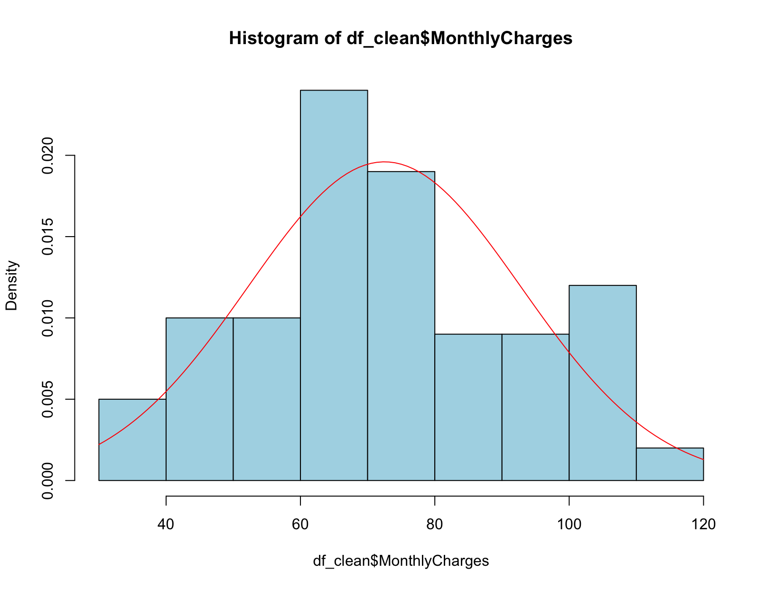
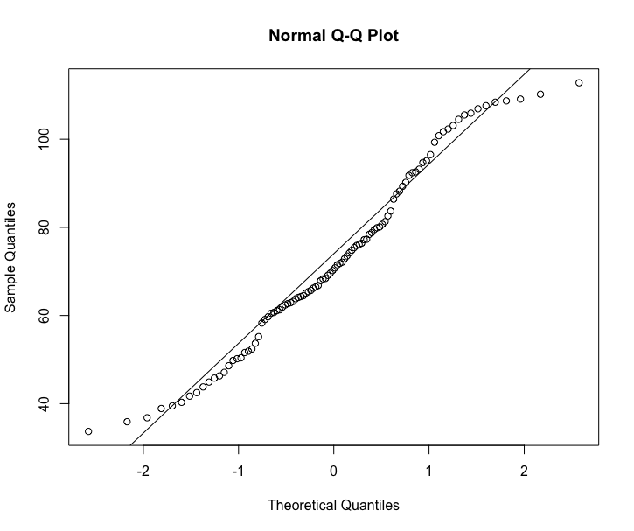
MODULE 3: PROBABILITY & DISTRIBUTION
Monthly Charges: Normal Distribution Fit (Mia)
Justification
Histogram of
Monthly Charges
Normal Q-Q Plot
Goal: Identify Financial Risk
Distribution indicates Bell Curve
Results | Interpretation
p-value=0.032 | Minor non-conformity; move forward with caution
Median > Mean ($.34 difference) | $72.85 > $72.51 approximate symmetry with more low paying customers pulling average down
QQ Line Plot Alignment | Minimal tail variance = Normal Distribution Assumption for risk modeling can be used
Notes:
Speaker Notes:
. As shown in the image above we see that when comparing our previous results to monthly charges, we now shift into looking at continuous consumer behavior in a sense. Now although there is deviance the charges follow an approximate normal distribution pattern, as shown by the bell curve above. This is also backed up by the close range we see in the mean and median. This means that although our pricing is consistent, most of our customers are spending at a price point around $72.50. Because the median is slightly greater than the mean, we now know that the average customer is paying $0.34 more than what the average suggests.
The Shapiro-Wilk test revealed a p-value of .032. Now, this is less than the 0.05 threshold, meaning that the data has some non-normal characteristics such as slight skews and heavy tails as seen at the highest and lowest point of the QQ plot line.
However, because the QQ plot line shows that the majority of data does follow that line, we can treat this event as approximately normal and move forward with our financial risk assessment while acknowledging that there is some slight variance and further supporting our idea that the company has segmented users based on the amount of services they have.

Slide 12

MODULE 4: CONFIDENCE & RECOMMENDATIONS
Confidence Intervals (Lin)
Monthly Charges (95% CI)
Churn Rate (95% CI)
CLT Justification
$68.47 – $76.54
19.2% – 36.9%
With n = 100, the Central Limit Theorem guarantees sampling distributions are approximately normal — validating our normal-based inference.
We are 95% confident the true population mean monthly charge falls in this range — anchoring revenue forecasts.
A wide interval reflecting sample size limits — plan retention budgets for the upper bound.
Management implication: Budget retention programs assuming up to 37% churn risk to avoid mid-year shortfalls.
Notes:
We are 95% confident the average bill across the entire customer base is somewhere between $68.47 and $76.54.
The 95% CI for churn places the true rate between 19.2% and 36.9%. Even the optimistic lower bound represents one in five customers lost per cycle.
The Central Limit Theorem says that sample means tend toward a normal distribution regardless of the underlying data's shape

Slide 13
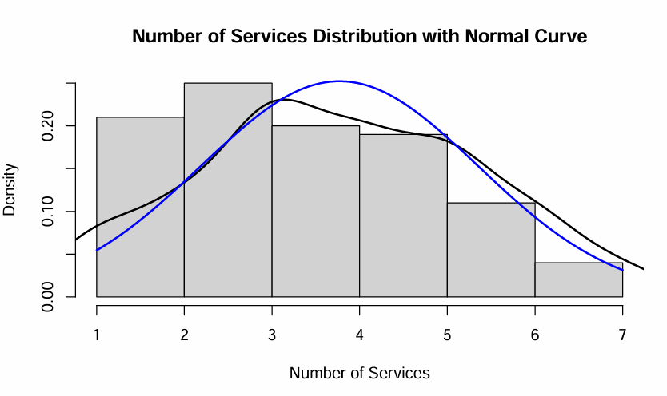
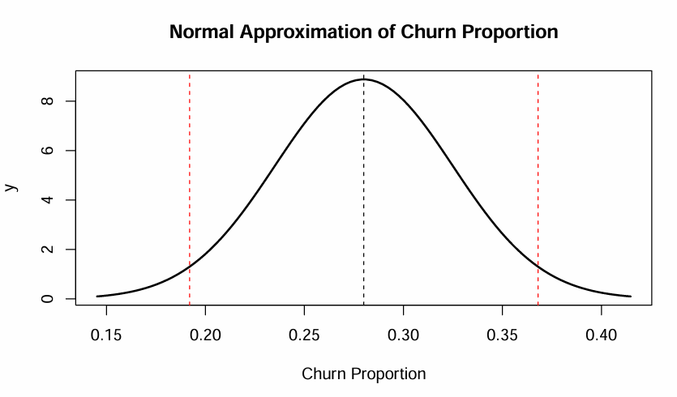
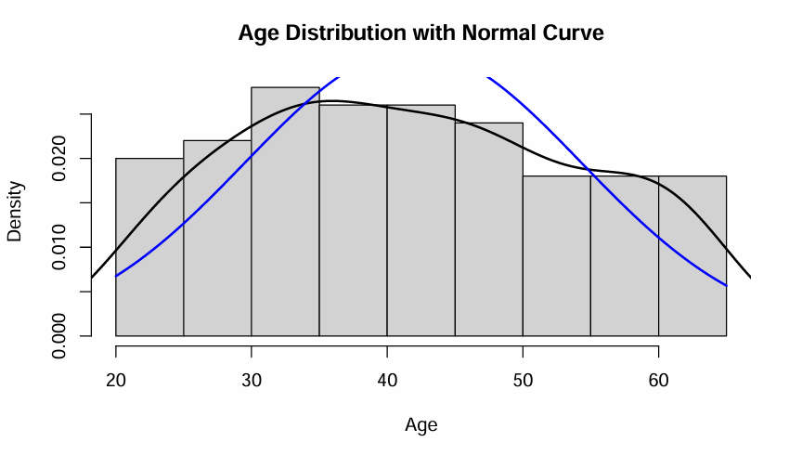
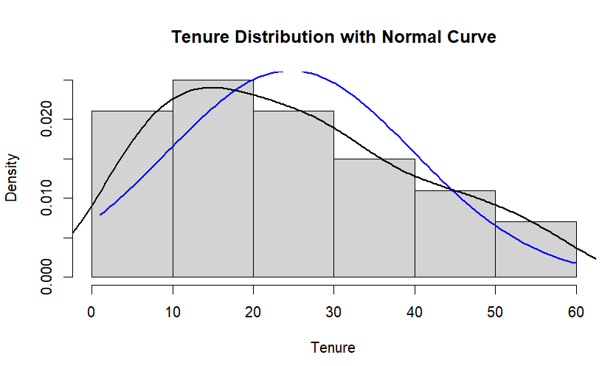
Histogram of Normal Distribution (Lin)
Notes:
A normal distribution is a probability distribution that is symmetric around its mean, where data clusters around a central value with no bias left or right.

Slide 14
MODULE 4: CONFIDENCE & RECOMMENDATIONS
Key Findings (Lin)
Critical Danger Zone
Age Matters
The Safety Zone
Churn peaks between months 6–10. New customers need targeted intervention before this window closes.
Churners average 27 years old; retained customers average 47. Younger segments demand different engagement strategies.
Customers with 4+ services show 0% churn. High engagement is the strongest predictor of loyalty.
Notes:
the company has a high customer churn rate because most customers churn between months 6 and 10. In addition, customers subscribed to only 1 or 2 services churns at 100%, and those with 3 services churns at 28%. It explains the lack of effectiveness in the company's cross-selling and customer engagement strategies. Furthermore, churned customers are on average 27 years old, and retained customers are on average 47 years old. This means that the company's services are not approved by younger customers. Finally, churned customers pay an average of about $48.90 per month, and retained customers pay about $81.70 per month. This means the company is losing the lower-income customers.

Slide 15
MODULE 4: CONFIDENCE & RECOMMENDATIONS
Business Recommendations (Logan)
01
02
03
Early Intervention (<12 Months)
Lock in Customers Into 4+ Services
Age-Specific Campaigns for Under-30
Who: Marketing team · When: Month 3
Check-ins for new customers is imperative to determine customer satisfaction.
Who: Sales & CX teams · When: Quarterly account reviews
Persuade customers to subscribe to higher bundles for a smaller churn rate.
Who: Digital marketing · When: Continuous, social-first channels
Attract and keep viewers under 30 years old.

Slide 16
MODULE 4: CONFIDENCE & RECOMMENDATIONS
Limitations (Lin)
Simulated Data
Sample Size
No Time Series
100 clean rows leave out real-world noise such as missing values, data-entry errors, and edge cases.
Wide confidence intervals reflect limited observations; real telecom datasets span millions of records.
This cross-sectional snapshot misses seasonal trends and campaign effects over time.
Future Analysis
Seasonal Fluctuations
Competitor Pricing
Model churn across contract renewal cycles and promotional windows.
Integrate market-rate data to isolate price-sensitivity effects.
Notes:
Simulated Data Only 7 columns are present (CustomerID, Tenure, MonthlyCharges, NumServices, Churn, Age, Gender). Missing are potentially important drivers like contract type, payment method, geographic region, data usage, customer service interactions, or plan tier — all commonly predictive of churn.
Sample Size With only 100 observations, the margins of error are wide — especially for the churn rate (±8.8 percentage points). This makes precise inference difficult and limits how confidently conclusions can be generalized.
No Time Series This cross-sectional snapshot misses seasonal trends and campaign effects over time.
Whether churn spikes in specific months. Whether average monthly charges fluctuate due to overage fees, promotional discounts, or usage surges.
Whether customers who pay more than competitors are significantly more likely to churn. Which customer segments are most price-sensitive.
Li, C., Swaminathan, S., & Kim, J. (2025). Point Redemption in Loyalty Programs: The Role of Customer Relationship Characteristics and Their Implications for Service Providers. Journal of Service Research, 28(4), 652–668. https://doi.org/10.1177/10946705241246341

Slide 17
Christian Worldview Integration (Lewis)
The Statistical methods and ethical commitments embedded in this analysis align with several foundational biblical principles. Each principle below is applied to a specific aspect of the dataset:
Honest Measurement (Proverbs 11:1 “A false balance is an abomination to the lord, but a just weight in his delight”). The careful and accurate computation of descriptive statistics such as mean, median, standard deviation and IQR, reflects the biblical mandate for honest and precise measurement.
Faithful Stewardship of Resources (Luke 16:10 “Whoever is faithful in very little is also faithful in much”). Customer churn analysis is fundamentally an exercise in stewardship. Every customer who churns represents a loss of entrusted revenue and relationship.
Truthful Witness and Transparency (Ephesians 4:25 “ Therefore, having put away falsehood, let each one of you speak the truth with his neighbor.”). Explicitly acknowledging that this dataset is simulated and clearly stating that findings cannot be generalized to real telecom populations, reflects the biblical call to honest witness.

Slide 18
References
Fryer, Thomas. (2026). Bus 534 Week 3: Chapter 2 - Uncertainty Quantification. [Powerpoint slides]. School of Business, California
Baptist University. https://calbaptist.blackboard.com/ultra/institution-page
Li, C., Swaminathan, S., & Kim, J. (2025). Point Redemption in Loyalty Programs:
The Role of Customer Relationship Characteristics and Their Implications for Service Providers.
Journal of Service Research, 28(4),652–668.
https://doi.org/10.1177/10946705241246341
Raghunathan, T. E. (2021). Synthetic data. Annual Review of Statistics and Its Application, 8(1), 129–140.
https://doi.org/10.1146/annurev-statistics-040720-031848
Taddy, M., Hendrix, L., & Harding, M. C. (2022). Modern business analytics: With R: Data-driven decision making.
McGraw-Hill Education.
The Holy Bible, King James Version. (n.d.).
Verbeke, W., Dejaeger, K., Martens, D., Hur, J., & Baesens, B. (2012). New insights into churn prediction in the telecommunication industry:
A profit driven data mining approach. European Journal of Operational Research, 218(1), 211–229.
        https://doi.org/10.1016/j.ejor.2011.09.031

Slide 19
Appendix A: AI Transparency
Section | Members | AI Used + Hyperlink | AI Contribution
Business Context I Research Questions I Recommendations | Logan | N/A | N/A
Data Description I Christian Worldview Integration | Lewis | Claude | Understanding simulated nature of dataset vs real world scenario and providing biblical principles.
Descriptive Exploratory Analysis Sections | Zikun | Claude | Learn R coding and data analysis.
Probability & Distribution Sections | Mia | Gemini | Aided in R coding, creating deliverable checklist, and analysis
CI's I Key Findings I Limitations & Future Analysis | Lin | Claude | Create R code and analyze data
PowerPoint Design | Mia | Gamma | PowerPoint template creation aid

Slide 20
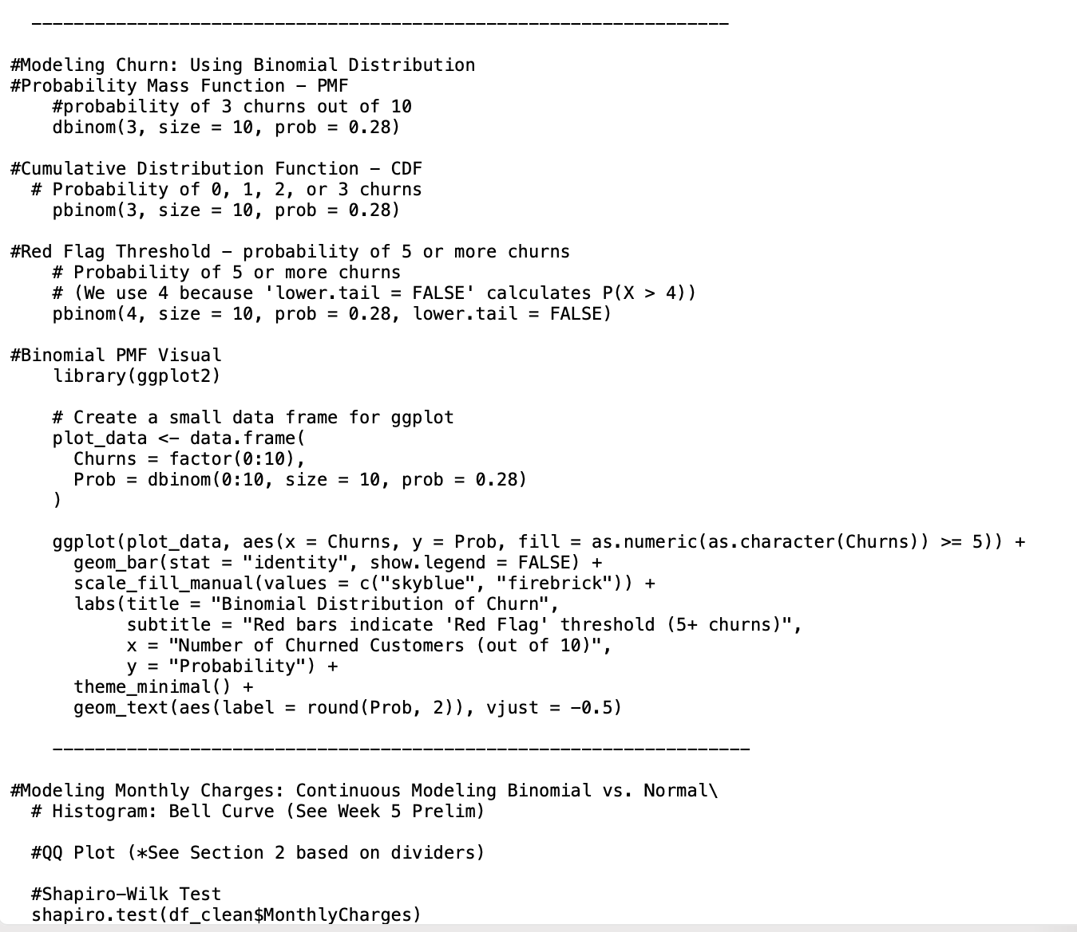
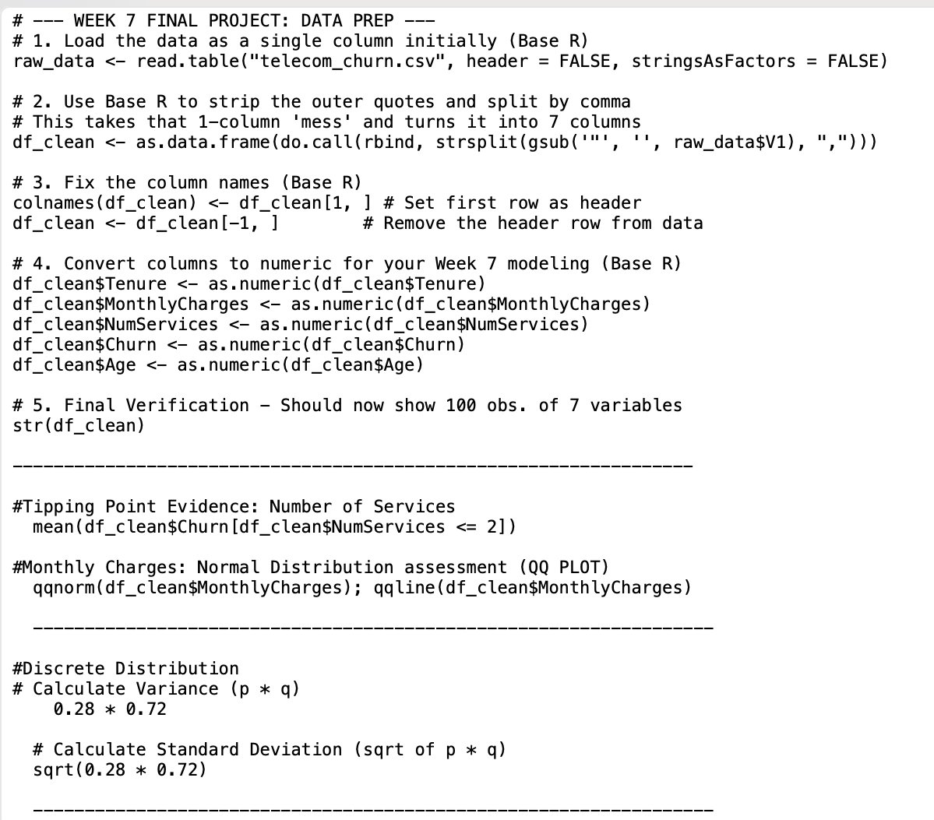
Appendix B: Key R Code
R Code of probability and distribution sections

Slide 21
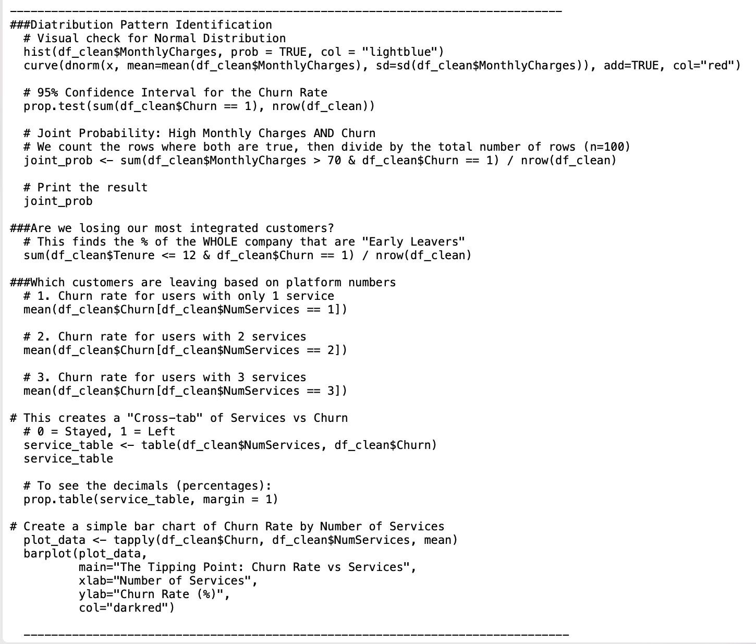
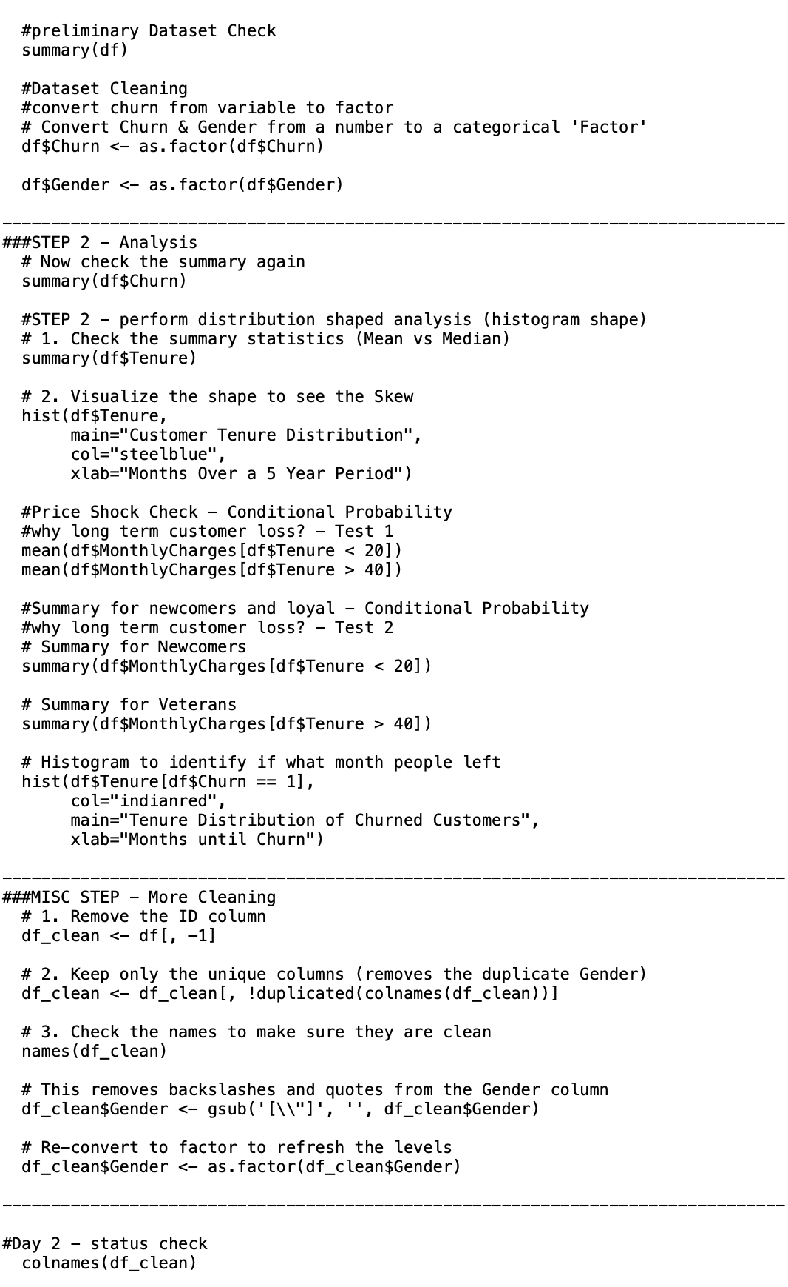
Appendix B: Key R Code Continued

Slide 22
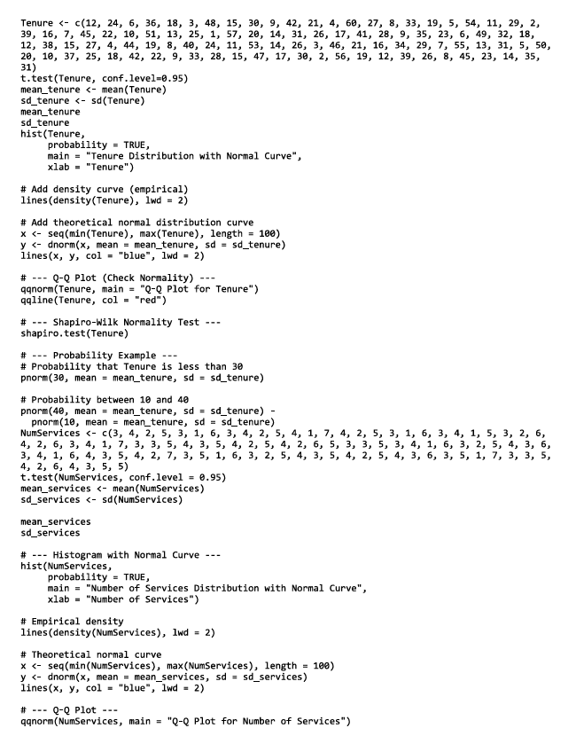
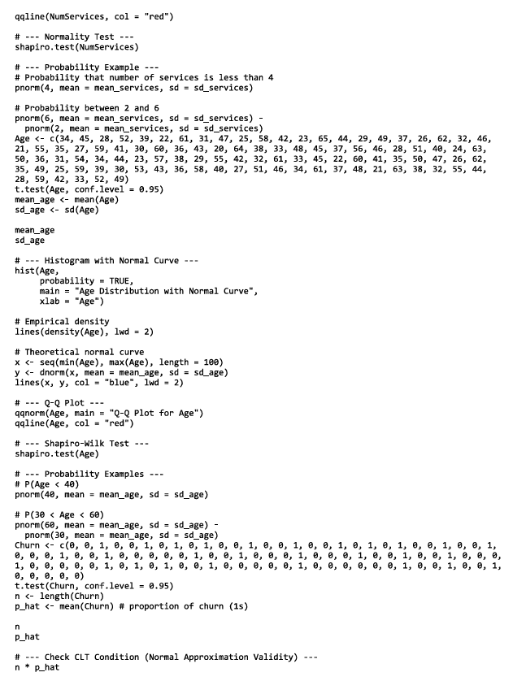
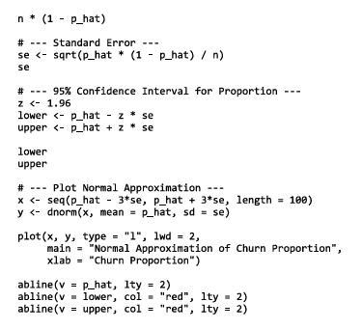

Appendix B: Key R Code Continued
R Code of Confidence Intervals and Normal distribution

